Slide 1
Compiler Construction
Teacher : Zulfiqar Ali
Email: Zulfiqar.rafique@nu.edu.pk
Office: No.6,Basement -1 (CS Block 1)

Slide 2
Week 2:
Role of Lexical Analyser
Input Buffering
Specification and recognition of tokens
Regular Expressions
Finite Automata (DFA & NFA)

Slide 3
Role of Lexical Analyser
Read the Input characters
Group them in Lexemes
Produce sequence of Tokens as Output
The stream of tokens is sent to the parser for syntax analysis.
Interact with the symbol table
When any identifier constitute put its information in symbol table
Stripping out comments and whitespace (blank, newline, tab, and may be some other characters)
Generate Errors which relates to Lexical Analysis.
Lexical Analyzer may keep track record of line numbers to associate any error

Slide 4
Input Buffering
Challenge in Lexeme Recognition:
Reading source code efficiently is tricky because lexemes often require lookahead (checking extra characters) to confirm boundaries.
Why Lookahead is Needed:
Identifiers: End only when a non-alphanumeric character (e.g., space, operator) is encountered.
Multi-character Operators: Single chars like -, =, or < could be part of longer ops (e.g., ->, ==, <=).
Examples: x, iffy, &, &&

Slide 5
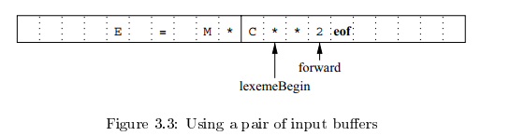
Solution: Two-Buffer Scheme: (Buffer Pair)
Handles large lookaheads safely by dividing input into two buffers, allowing seamless scanning.
Two buffers (size = disk block, e.g., 4096 bytes) alternate to minimize system call.
Special eof marker indicates end of file.
lexemeBegin: Points to the start of the current lexeme.
forward: Scans ahead to identify lexeme boundaries.

Slide 6
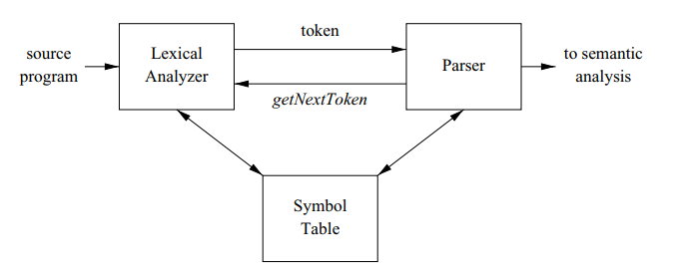
Interaction with Symbol Table

Slide 7
Tokens, Patterns, and Lexemes
Term | Definition | Example (int x = 10;)
Lexeme | Actual substring in code | "int", "x", "10"
Pattern | Rule defining valid lexemes | [a-z]+ (for identifiers)
Token | Categorized lexeme ((TYPE, "int")) | (INT, 10), (ID, "x")

Slide 8
Kinds of Tokens
Most Languages have the tokens in these categories
Keywords – If, Else, Do, While
Identifiers - num, var, addfunction
Operators (+, -, *, /, <, >, <=)
Numbers/Constants 362, 457
Strings/Literals “This is literal”
Punctuators , “ “ ()[] ;
Special Characters & % ^ @

Slide 9
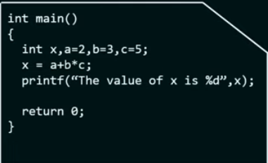
Example of Tokenization
Keywords:
Identifiers:
Operators:
Strings/Literals:
Punctuators:
Constants:
Special Characters:

Slide 10
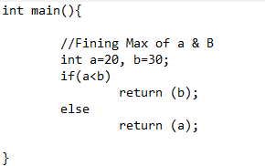
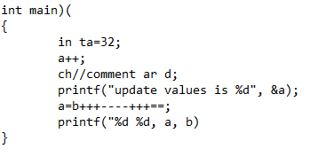
Exercises (Find the number of tokens)
Printf(“i=%d, &i=%x” , I, &i);

Slide 11
Symbol Table
Symbol tables are data structures that are used by compilers to hold information about source-program constructs
It allow the compiler to find the record for each name quickly and to store or retrieve data from that record quickly.
The information is collected incrementally by the analysis phases of a compiler and used by the synthesis phases to generate the target code.

Slide 12
Symbol Table Usage by Phases
Symbol Table | Lexical Analysis | Create entries for identifiers
 | Syntax Analysis | Adds information regarding attributes(type, Scope, dimension etc)
 | Semantic Analysis | Perform type checking, ensuring that expressions and assignments are semantically correct.
 | Intermediate Code Generation | Available info helps in adding temporary variable information
 | Code Optimization | Available info helps in perform various optimizations, such as identifying redundant computations or optimizing memory access patterns.
 | Target Machine Code | The symbol table provides the memory addresses or register assignments for identifiers, which are crucial for generating the final machine code.

Slide 13
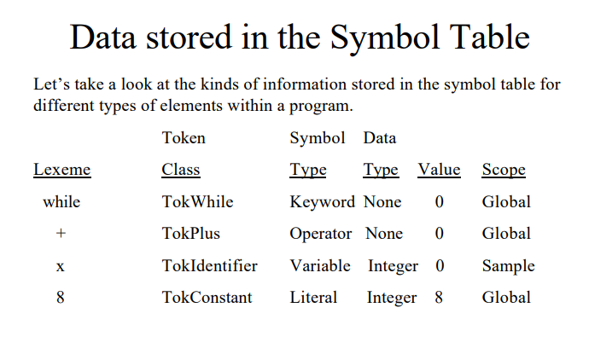

Slide 14
Errors
Errors
Compiler Time Errors
Lexical Errors
Syntax Errors
Semantic Errors
Run Time Errors

Slide 15
Lexical Errors
It is hard for a lexical analyzer to tell, without the aid of other components,
fi ( a == f(x))
A lexical analyzer cannot tell whether fi is a misspelling of the keyword if or an undeclared function identifier.
Since fi is a valid lexeme for the identifier token type.
This error may be handled by Parser.

Slide 16
Lexical Errors
Identifiers that are too long (anidentifierrrrrrrr……..)
Exceeding length of Numeric Constants (int i = 454654564654;)
Ill-formed numeric constants (45$36)
Illegal characters which are not available in language (char x[]=“FAST NUCES”;$)

Slide 17
Lexical Errors Recovery
Panic Mode Recovery
int 4FAST; characters will be skipped until semicolon (Punctuator)
For(i=0; i<=10;i++){ in any line if Lexical Error found then from that line all code will be skipped until any delimiter found, Like }
Transpose of Two Adjacent Characters
itn -- > int, unoin-→ union
Inserting a missing character
it num; error handler may add n, to make it int
Deleting an unknown or extra character
intt num; error handle may remove extra t, int num;
Replace a character by another
itt num to int num

Slide 18
Regular Expressions
Regular expressions are a convenient way to specify various simple sets of strings.
They are of practical interest because they can specify the structure of the tokens used in a programming language.
Regular expressions (REs) are a language for expressing patterns.

Slide 19
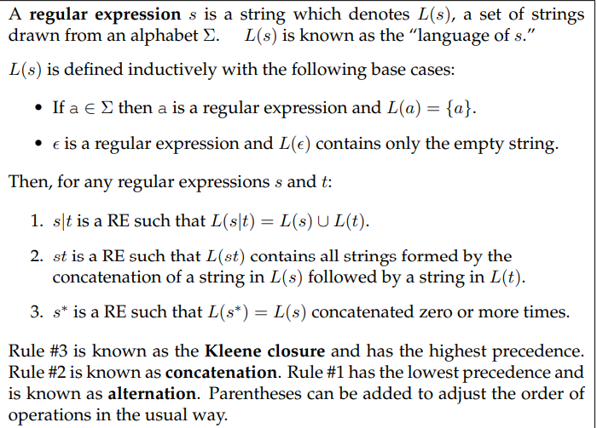

Slide 20
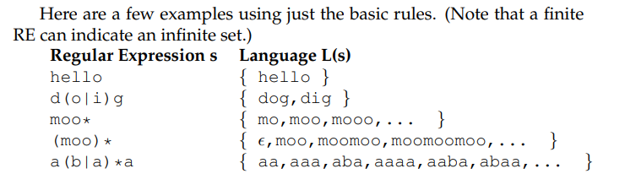
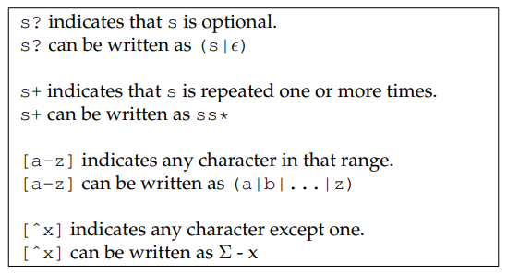
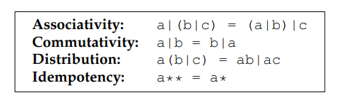

Slide 21
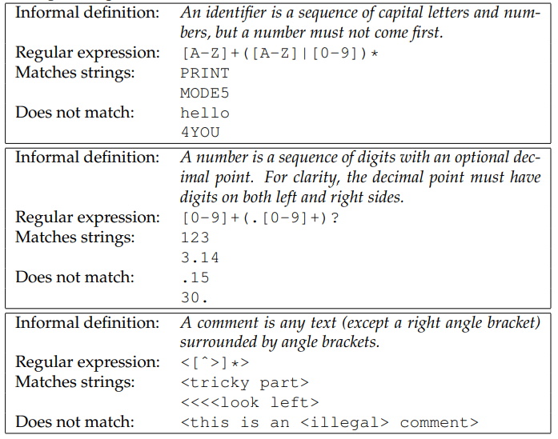

Slide 22
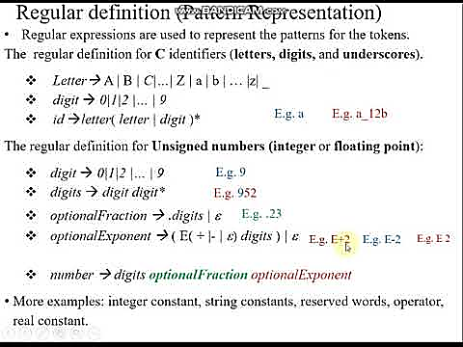

Slide 23
Exercises for Regular Expressions
Write a Regular Expression for Identifiers (Format: must start with a small alphabet, followed by number/alphabet/_)
Write a regular Expression for Decimal Point Numbers
Write a Regular Expression for Keywords : If, For, While

Slide 24
Finite Automata
A finite automaton (FA) is an abstract machine that can be used to represent certain forms of computation.
Graphically, an FA consists of a number of states (represented by numbered circles) and a number of edges (represented by labelled arrows) between those states.
Each edge is labelled with one or more symbols drawn from an alphabet Σ
Types
Deterministic FA
Non-Deterministic FA

Slide 25
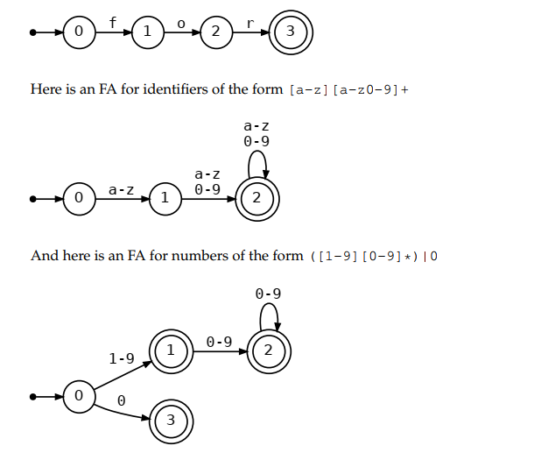

Slide 26
DFA – Deterministic FA
A DFA is a special case of an FA where every state has no more than one outgoing edge for a given symbol.
A DFA has no ambiguity: for every combination of state and input symbol, there is exactly one choice of what to do next.
Because of this property, a DFA is very easy to implement in software or hardware.

Slide 27
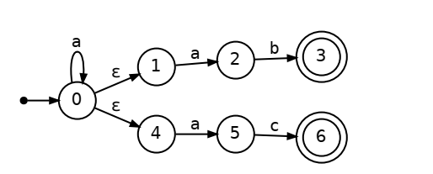
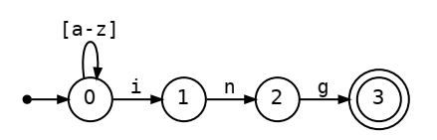
Non-Deterministic FA
An NFA is a perfectly valid FA, but it has an ambiguity that makes it somewhat more difficult to work with.
Consider the regular expression [a-z]*ing, which represents all lowercase words ending in the suffix ing.

Slide 28
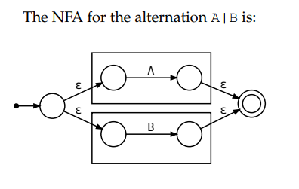
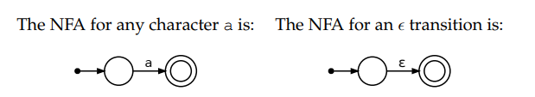
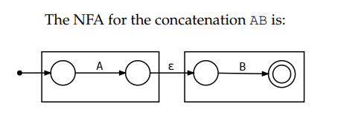
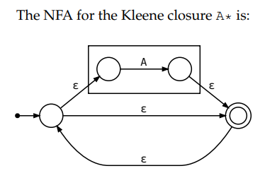
Converting RE’s to NFA’s

Slide 29
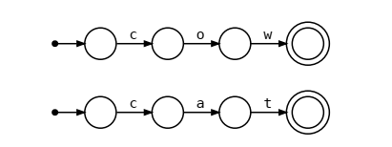
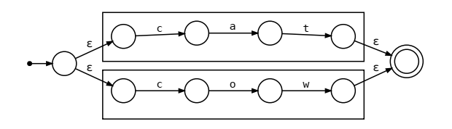

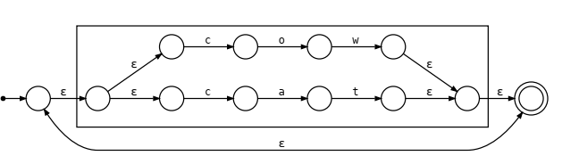
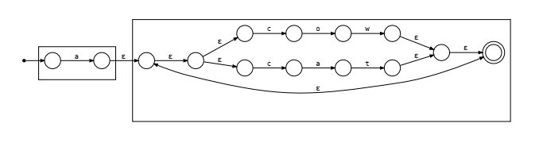
Converting RE’s to NFA’s

Slide 30

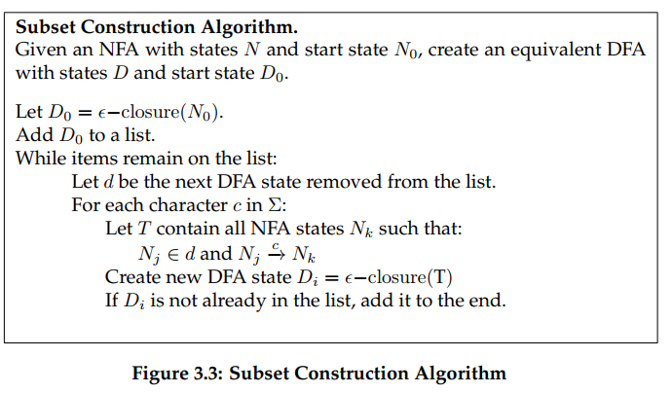
Converting NFA’s to DFA’s (Subset Construction)

Slide 31
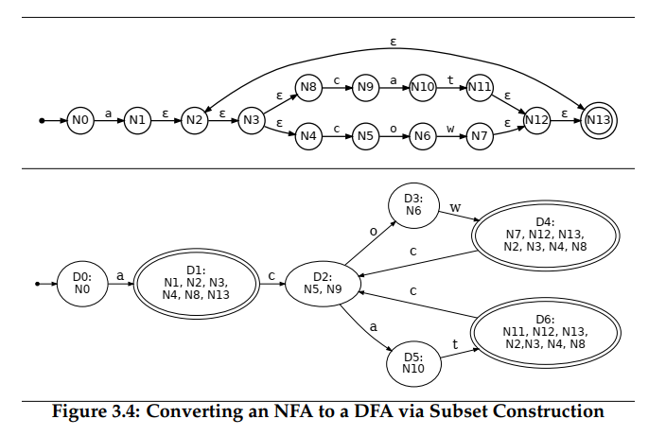

Slide 32
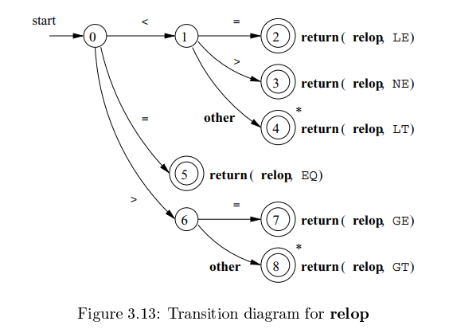
Token Recognition

Slide 33
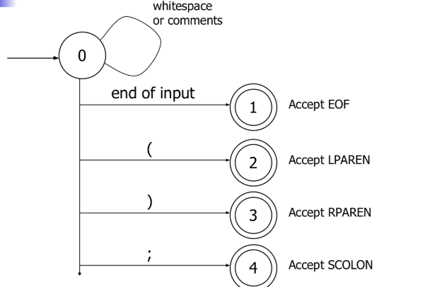
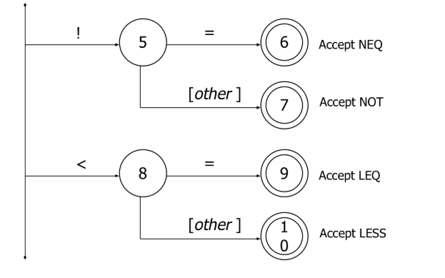

Slide 34
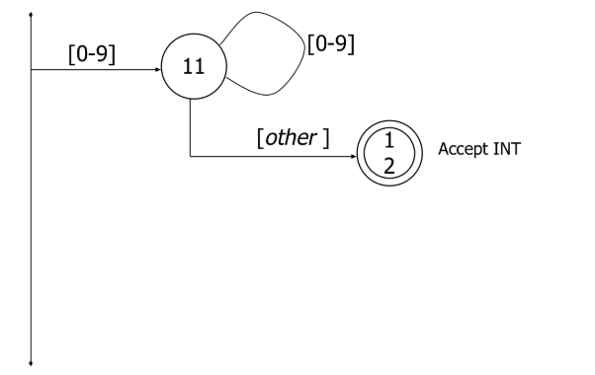
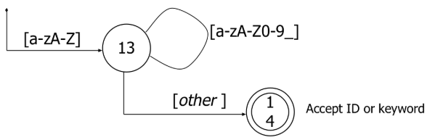

Slide 35
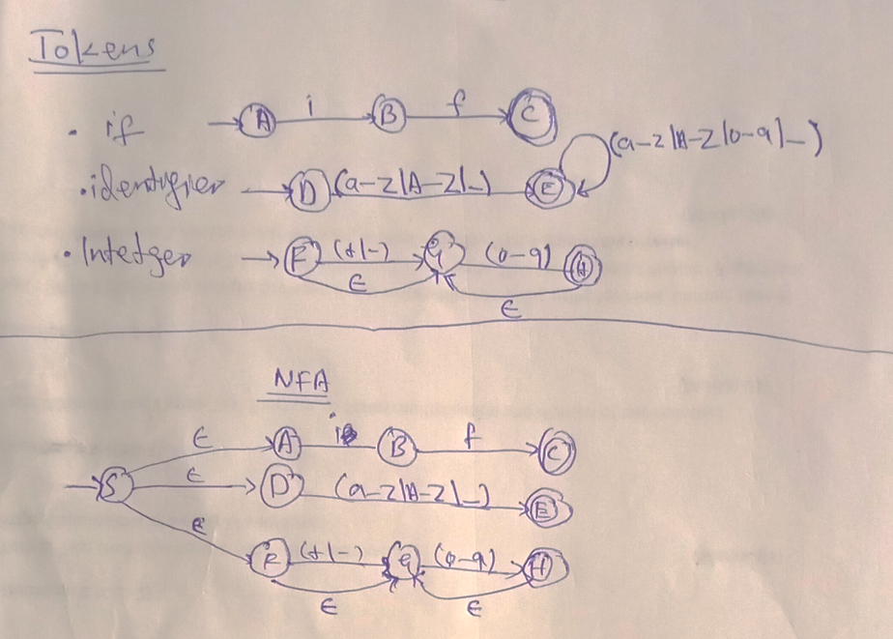

Slide 36
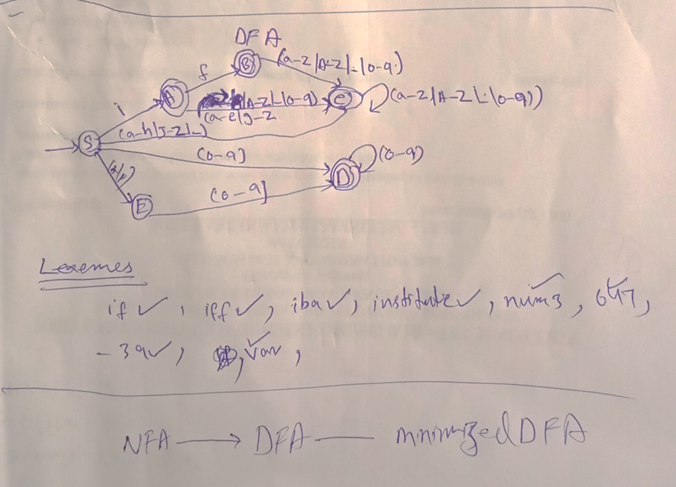

Slide 37
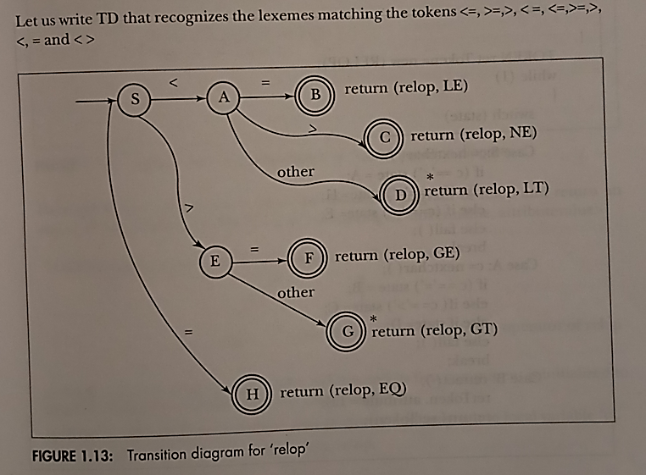
Relational Operators Transition Diagram (TD)

Slide 38
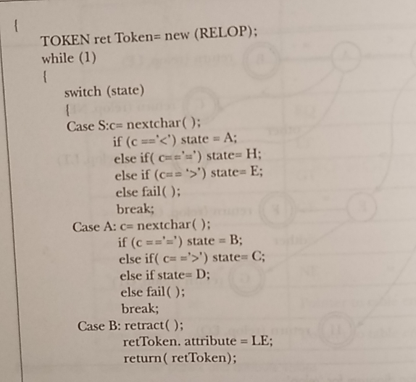
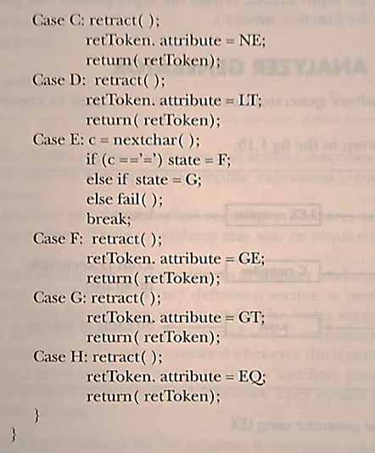
Relational Operators Program(For Lexical)

Slide 39
Reference:
Compilers: Principles, Techniques, and Tools 2nd Edition by Alfred Aho , Jeffrey Ullman, Ravi Sethi, Monica Lam
Introduction to Compilers and Language Design | Second Edition | Prof. Douglas Thain - University of Notre Dame

